Slide 1

Sentiment Analysis on Yelp Review Dataset
By Shreyas Shivakumar Kasetty
UIN: 534002320
Course:
CSCE 633 (Machine Learning)

Slide 2
INTRODUCTION
Evolution of Sentiment Analysis:
Sentiment analysis has undergone a remarkable evolution, advancing from basic text classification to sophisticated deep learning methodologies.
This growth is propelled by the surge of social media, where users continuously generate vast amounts of opinion-rich text.
Impact of Social Media Data:
Social media platforms, have become goldmines for opinionated data, offering real-time insights into public sentiment.
The analysis of such data is vital, as it sheds light on customer preferences and experiences, shaping business strategies and decision-making.
Importance in Business and Analytics:
For businesses, especially in the hospitality and service sectors, understanding customer feedback on platforms like Yelp is key to adapting and thriving.
Sentiment analysis helps translate unstructured feedback into actionable insights, driving customer engagement and satisfaction.

Slide 3
Project Objectives
Building a Transformer Model for Sentiment Analysis:
Develop a transformer model tailored for analyzing sentiments in Yelp restaurant reviews.
Utilize NLP techniques to process and interpret complex textual data efficiently.
Utilize hyperparameter tuning techniques to optimize the model to better accuracy results.
Achieving Comprehensive Sentiment Analysis:
Aim to accurately classify a wide range of sentiments in Yelp reviews, from positive and negative to neutral.
Ensure the model can understand and interpret various linguistic nuances, context, and subtleties present in customer feedback.

Slide 4
Methodology
Dataset Preprocessing:
Text Normalization: Converting all text to a standard format, typically lower case, to ensure consistency
Stop Words Removal: Eliminating common words that provide little value in understanding the sentiment of the text.
Punctuation Removal: Stripping punctuation marks, which are generally not informative for sentiment analysis models.
Data Augmentation: Applying techniques such as back-translation to enhance the robustness of the dataset by artificially increasing its size and variety.
Tokenization: Splitting text into individual words or tokens to facilitate further processing.
Hyper Parameter Tuning:
Grid Search: Different combinations of hyperparameter values were used to search for the best combination.

Slide 5
Transfer Learning with RoBERTa
Understanding Transfer Learning:
Transfer learning involves taking a model that's been trained on a large dataset and adapting it to a specific task.
It's like giving a head start to the model, so it doesn't learn from scratch.
RoBERTa as a Pretrained Model:
RoBERTa is a robustly optimized version of BERT, pre-trained on an extensive corpus of text.
It's designed to understand the context and nuances of language
Benefits of Using RoBERTa:
Leveraging RoBERTa saves significant computational resources and time.
It provides a deep understanding of language, which is crucial for accurate sentiment analysis.

Slide 6
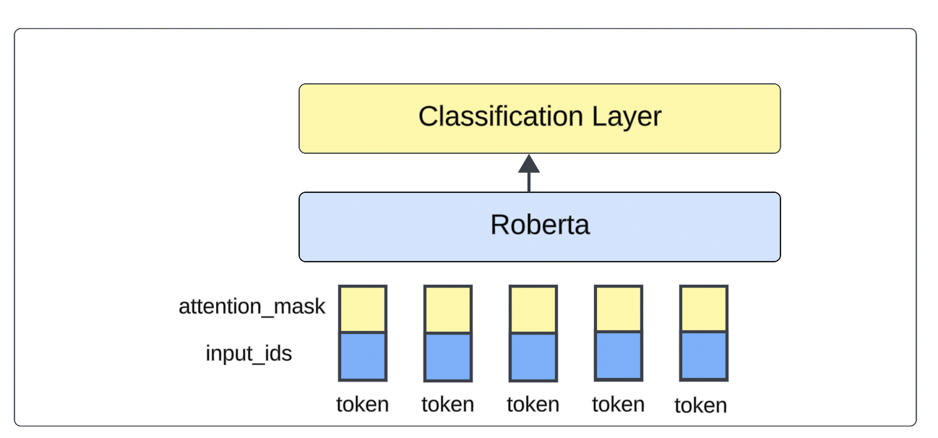
RoBERTA-Simple Architecture

Slide 7
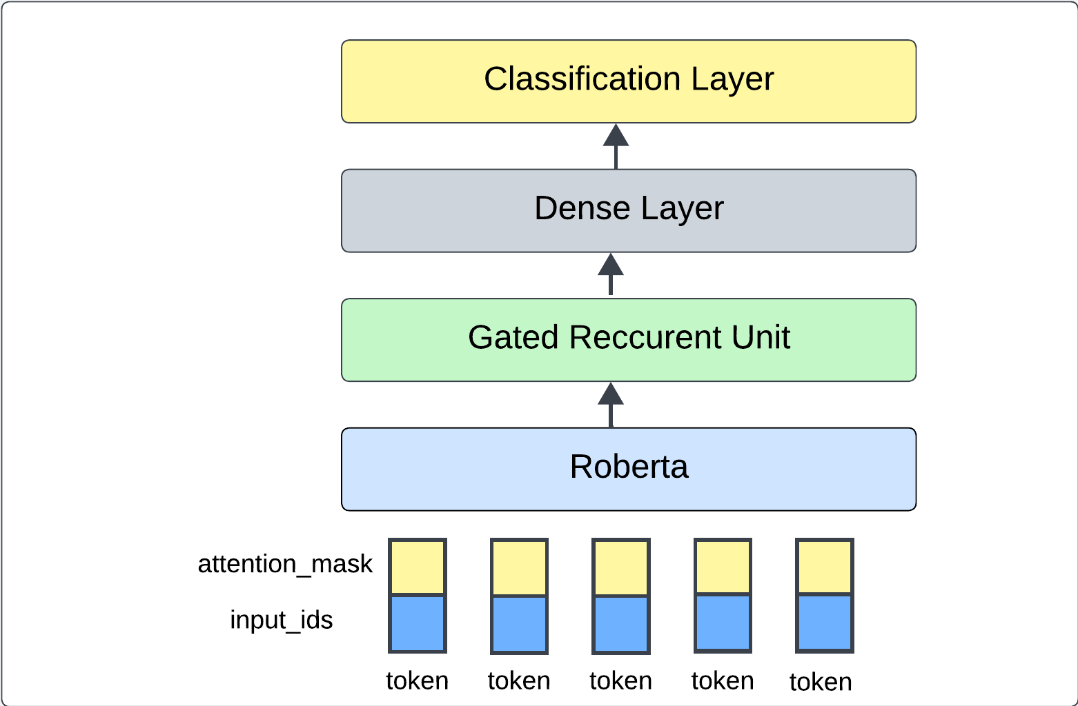
RoBERTA-GRU Architecture

Slide 8
Train DATASET

